Slide 1
Virtual Memory
Motivation:
Each process would like to see its own, full, address space
Clearly impossible to provide full physical memory for all processes
Processes may define a large address space but use only a small part of it at any one time
Processes would like their memory to be protected from access and modification by other processes
The operating system needs to be protected from applications

Slide 2
Virtual Memory
Basic idea:
Each process has its own Virtual Address Space, divided into fixed-sized pages
Virtual pages that are in use get mapped to pages of physical memory (called page frames).
  Virtual memory: pages
  Physical memory: frames
Virtual pages not recently used may be stored on disk
Extends the memory hierarchy out to the swap partition of a disk

Slide 3
Virtual and Physical Memory
Example 4K page size
Process 1 has pages
A, B, C and D
Page B is held on disk
Process 2 has pages
X, Y, Z
Page Z is held on disk
Process 1 cannot access pages X, Y, Z
Process 2 cannot access page A, B, C, D
O/S can access any page (full privileges)
Virtual memory
(process 1)
Virtual memory
(process 2)
Physical memory
0
A
0
Y
0
X
4K
B
4K
D
4K
Y
8K
8K
8K
12K
12K
A
12K
16K
16K
C
16K
20K
C
20K
X
20K
Z
24K
24K
28K
page
swapping
28K
32K
D
32K
36K
36K
36K
B
36K
Z
Swap disk

Slide 4
Sharing memory using Virtual Aliases (Synonym)
Process 1 and Process 2 want to share a page of memory
Process 1 maps virtual page A to physical page P
Process 2 maps virtual page Z to physical page P
Permissions can vary between the sharing processors.
Note: Process 1 can also map the same physical
page at multiple virtual addresses !!
Virtual memory
(process 1)
Virtual memory
(process 2)
Physical memory
0
A
0
0
4K
B
4K
4K
8K
8K
8K
P
12K
12K
12K
16K
16K
Q
16K
20K
C
20K
20K
Z
24K
24K
28K
page
swapping
28K
32K
32K
36K
36K
36K
36K
P
Shared page
Swap disk
Q
Aliased within one process
Notes:
Virtual Alias : Two difference virtual addresses mapped to the same physical address.
Reasons: sharing a page (multiple processes).

Slide 5
Typical Virtual Memory Parameters
parameter | L1 cache | memory
Size | 4KB-64KB | 128MB-1TB
block/page | 16-128 bytes | 4KB-4GB
hit time | 1-3 cycles | 100-300 cycles
miss penalty | 8-300 cycles | 1M-10M cycles
miss rate | 0.1-10% | 0.00001-0.001%
H&P 5/e
Fig. B.20
Modern OS’s support several page sizes for flexibility. On Linux:
  Normal pages: 4KB
  Huge pages: 2MB or 1GB
Virtual Memory miss is called a page fault

Slide 6
Virtual Memory Policies
Block identification: finding the correct page frame
  Assigning tags to memory page frames and comparing tags is impractical (but variant of this method is used as we’ll see later)
  OS maintains a table that maps all virtual pages to physical page frames: Page Table (PT)
  The OS updates the PT with a new mapping whenever it allocates a page frame to a virtual page
  PT is accessed on a memory request to translate virtual to physical address → inefficient!
    Solution: cache translations (TLB)
  One PT per process and one for the OS
Notes:
The process of virtual to physical address translation is called a page table walk.

Slide 7
Virtual Memory Policies
Block placement: location of a page in memory
  More freedom → lower miss rates, higher hit and miss penalties
  Memory access time is already high and memory miss penalty (i.e., disk access time) is huge ⇒ must minimize miss rates
  As a result, memory is fully associative → a virtual page can be located in any page frame
    No conflict misses
    Important to reduce time to find a page in memory (hit time)
  To place new pages in memory, OS maintains a list of free frames
Block placement may be constrained by use of translated virtual address bits when indexing the cache (see later)

Slide 8
Virtual Memory Policies
Block replacement: choosing a page frame to reuse
  Minimize misses (page faults) → LRU policy
    True LRU expensive – must minimize CPU time of the algorithm
    Simple solution: OS sets a Used bit whenever a page is accessed in a time quantum. In the next quantum, any page with its Used bit clear is eligible for replacement.
  Minimize write backs to disk → give priority to clean pages
Write strategy: what happens when a page is written
  Write-through: would mean writing the cache block back to disk whenever the page is updated in main memory
  → not practical due to latency and bandwidth considerations
  (~4 orders of magnitude latency gap between memory & disk)
  Write-back: the norm in today’s virtual memory systems
    OS tracks modified pages through the use of Dirty bits in page table entries

Slide 9
Page Tables and Address Translation
Page Table Address Register
31
12
11
0
Virtual
Address
Virtual Page Number
PageOffset
Page Table Entry (PTE):
Track access permissions for each page
  Read, Write, Execute
Bit indicates if page is on disk, in which case Physical Page Number indicates location within swap file
“Dirty” bit indicates if there were any writes to the page
4B per PTE in this example
Disk?
Physical Page Number
Permiss.
Dirty
Valid
Page Table
0
r-w-x
0
1
PTE
31
12
11
0
Physical
Address
Physical Page Number
PageOffset
Notes:
Q: Can an application access the PT directly to perform translation? No, it is managed by the hardware page table walker.
Q: why would we want an X bit?

Slide 10
Making Page Tables space-efficient
The number of entries in the table is the number of virtual pages → many!
  e.g., 4KB pages
  → 2²⁰=1M entries for a 32b address space ➔ need 4MB/process
  → 2³⁶ entries for a 48b address space ➔ 64GB per process!
Solutions:
  Observation that the virtual address space of each process is sparse → only a fraction of all virtual addresses actually used
    Mapping between physical and virtual pages: inverted page table; hash virtual addresses to optimize search (PowerPC)
    Hierarchical page tables. (Intel, ARM)
  Use large pages

Slide 11
Fast address translation: TLB
Typically a small, fully- associative cache of Page Table Entries (PTE)
Tag given by VPN for that PTE
PPN taken from PTE
Valid bit required
D bit (dirty) indicates whether page has been modified
R, W, X bits indicate Read, Write and Execute permission
Permissions are checked on every memory access
Physical address formed from PPN and Page Offset
TLB Exceptions:
  TLB miss (no matching entry)
  Privilege violation
Often separate TLBs for Instruction and Data references
31
12
11
0
Virtual
Address
Virtual Page Number
PageOffset
V
D
R
W
X
Tag
Physical Page Number
=
=
=
=
=
TLB hit
Physical
Address
31
12
11
0
Physical Page Number
PageOffset

Slide 12
How to address a cache in a virtual-memory system
Option 1: physically-addressed caches → perform address translation before cache access
  Hit time is increased to accommodate translation ☹
Virtual address:
0x0004
Physical address:
0xc104
CPU
Main
memory
address
translation
L1 cache
tag
data
?

Slide 13
How to address a cache in a virtual-memory system
Option 2: virtually-addressed caches → perform address translation after cache access if miss
  Hit time does not include translation ☺
  Aliases ☹
Virtual address:
0x0004
Physical address:
0xc104
CPU
Main
memory
L1 cache
address
translation
tag
data
?

Slide 14
Problems with virtually addressed caches
Virtually tagged data cache problems:
  A program may use different virtual addresses pointing to the same physical address (Aliases or Synonyms)
    Two copies could exist in the same data cache
    Writing to copy 1 would not be reflected in copy 2
    Reading copy 2 would get stale data
    Thus, does not provide a coherent view of memory
  Also, must be able to distinguish across different processes: same VA, different PA (Homonyms)

Slide 15
Solutions for handling homonyms and synonyms
Flush cache on context switch or add process ID to each tag
  Will solve the homonym problem
  But will not solve the synonym problem.
Use physically addressed caches
  Will solve homonym problem.
  Will also solve synonym problem.
    Synonyms all have same physical address, thus one copy exists in each cache
  Implication: need to do address translation before accessing cache.
Use physically addressed tags?
  Must translate addresses before cache tag check
  May still be able to index cache using non-translated low-order address bits under certain circumstances.

Slide 16
VI-PT: translating in parallel with L1-$ access
Access TLB and L1-$ in parallel
Requires that L1-$ index be obtained from the non-translated bits of the virtual address.
This constraint in the number of bits available for the index limits the size of the cache!
31
12
11
0
Virtual Page Number
PageOffset
Virtual
Address
Index
Offset
31
12
11
5
4
0
IMPORTANT:
If the cache Index extends beyond bit 11, into the translated part of the address, then translation must take place before the cache can be indexed
L1-$
4 KB D-M
32-byte line
TLB
Tag
Comparison
TLB hit
Cache hit

Slide 17
Coping with large VI-PT caches
Problem: typical OS page size is 4-8KB. What if we want a larger L1 cache?
Multi-way caches: multiple blocks in the same set
  E.g., Intel i7: 32KB 8-way cache w/ 4KB pages
  High associativity affords large capacity
Check other potential sets for aliases on a miss
  E.g., AMD Opteron: 64KB 2-way cache w/ 4KB pages
  on a miss, 7 add’l cycles to check for aliases in other sets
Larger page size: more bits available for the index
  Not a universal solution, since most OS’s have a “standard” page size of 4-8KB

Slide 18
Coping with large VI-PT caches (con’d)
Rely on page allocator in the O/S to allocate pages such that the translation of index bits would always be an identity relation
  Hence, if virtual address A translates to physical address P, then
  Page Allocator must guarantee that: V[12] == P[12]
  This approach is referred to as “page coloring”.
Cache tag bits
Index
Offset
Cache addressing
31
13
12
5
4
0
31
12
11
0
Virtual Page Number
Page offset
Virtual addressing
Any translated bit used to index the cache must be identical in both the Virtual and Physical addresses

Slide 19
Summary: how to address a cache
PI-PT : Physically indexed, physically tagged
  Translation first; then cache access
  Con: Translation occurs in sequence with L1-$ access → high latency
VI-VT : Virtually indexed, virtually tagged
  L1-$ indexed with virtual address, tag contains virtual address
  Con: Cannot distinguish synonyms/homonyms in cache
  Pro: Only perform TLB lookup on L1-$ miss
VI-PT : Virtually indexed, physically tagged
  L1-$ indexed with virtual address, or often just the un-translated bits
  Translation must take place before tag can be checked
  Con: Translation must take place on every L1-$ access
  Pro: No synonyms/homonyms in the cache
PI-VT : Physically indexed, virtually tagged
  Not interesting

Slide 20
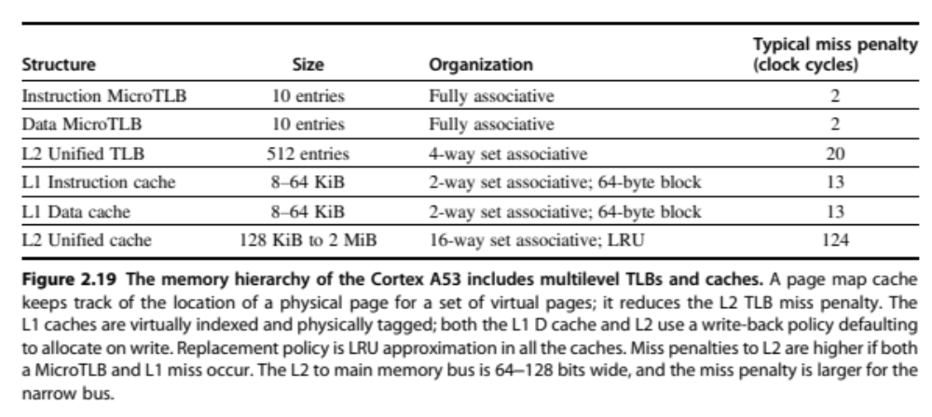
ARM Cortex- A53
From Hp 6

Slide 21
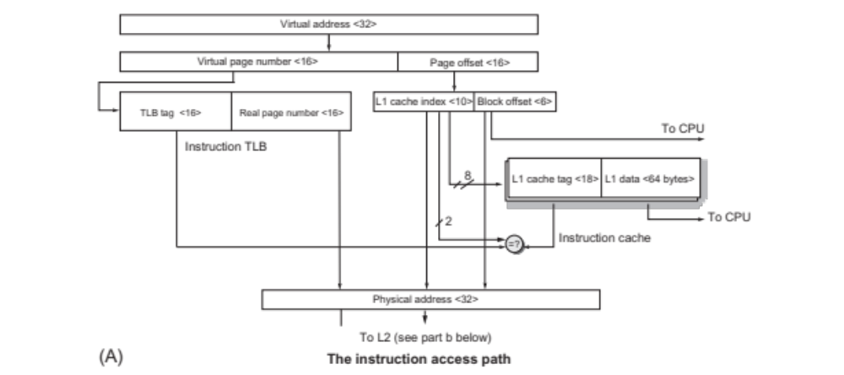
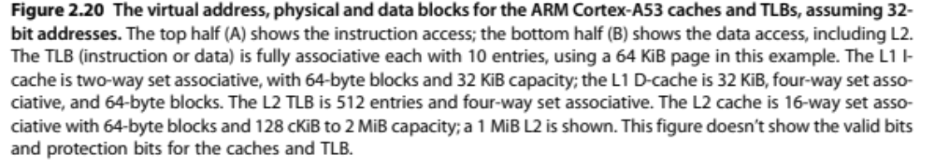
A53
64K page
L1 I: 32K, 2-way

Slide 22
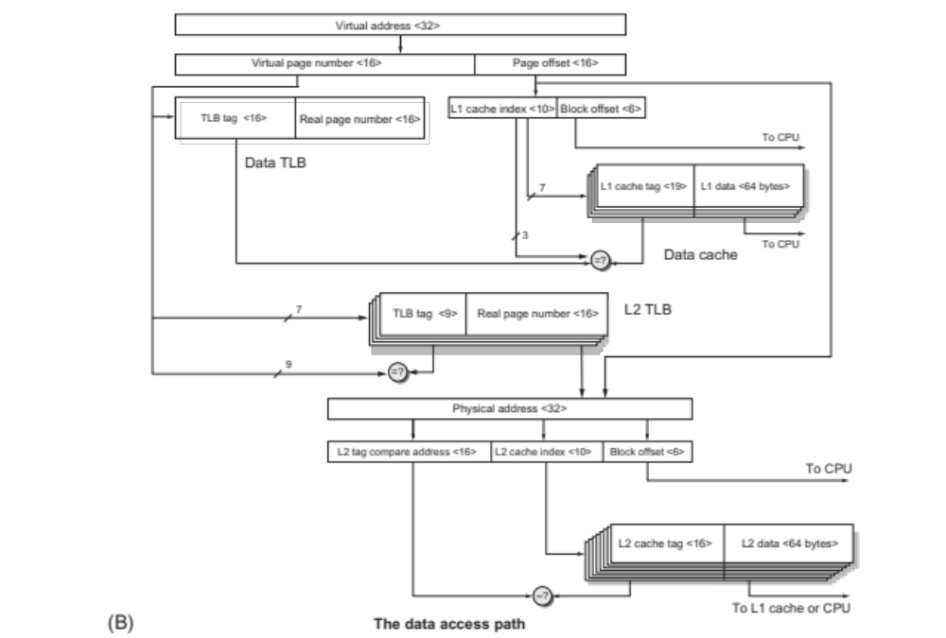
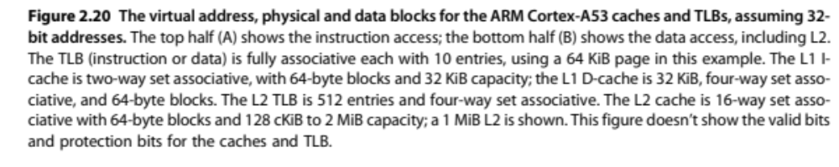
A53
64K page
L1 D: 32K, 4-way
L2 TLB: 512, 4-way
L2: 1MB, 16-way

Slide 23
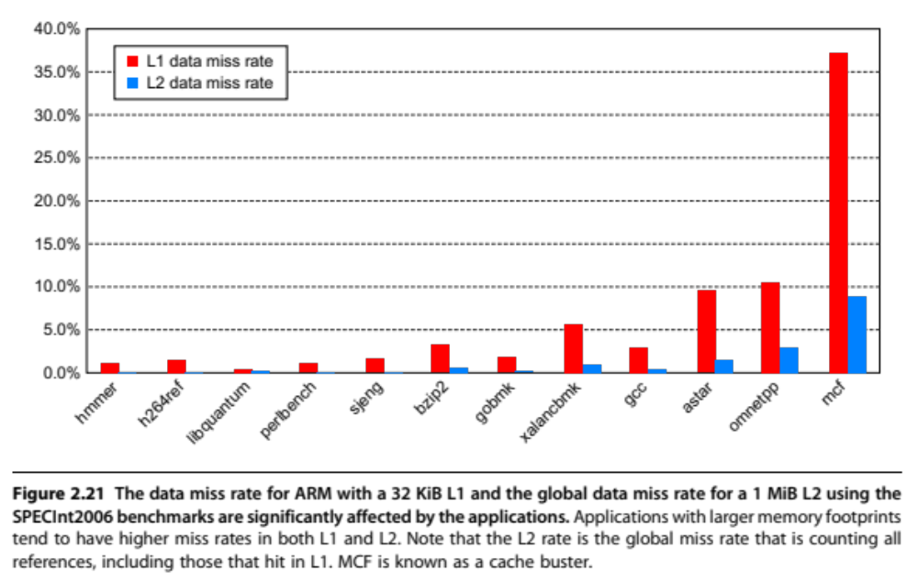
A53

Slide 24
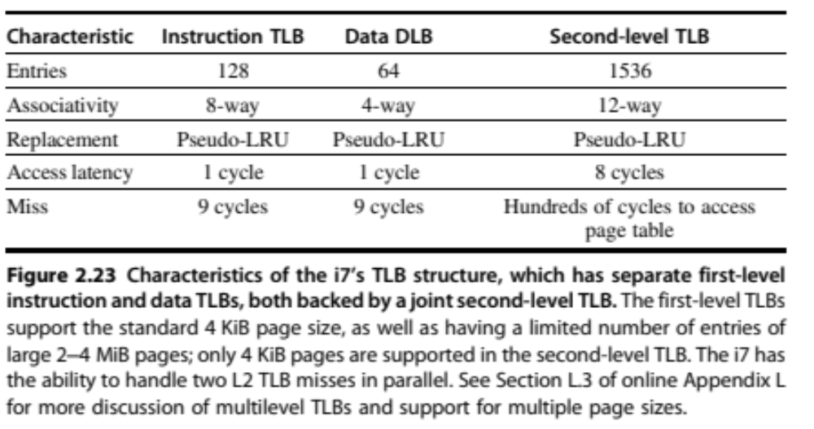
Intel i7

Slide 25
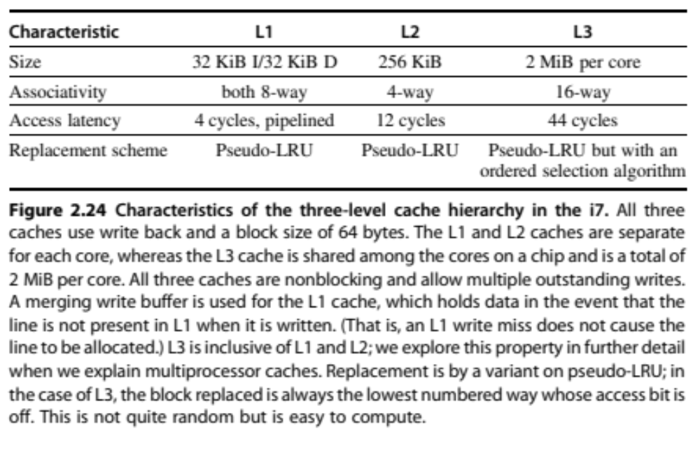
Intel i7

